Slide 1
Red team from the eyes of the log

Slide 2

About thyself
Kyle Schleich
From the nice cold land known as Rochester
Occasionally do some android shenanigans.
Sometimes do that logging thing
Oh and cats… Why the cats…
Notes:
Me I am me my name? KYLE SCHLEICH I am in fact from rochesterrrrrrr
Things I actually do,
Android reversing and man in the middle attacks.
I think I do logging related things sometimes. Honeypot shenanigansss was a thing I did at one point. Oh and I am the guy behind the labhijack script, bringing the music to the lab one rdp session at a time.

Slide 3
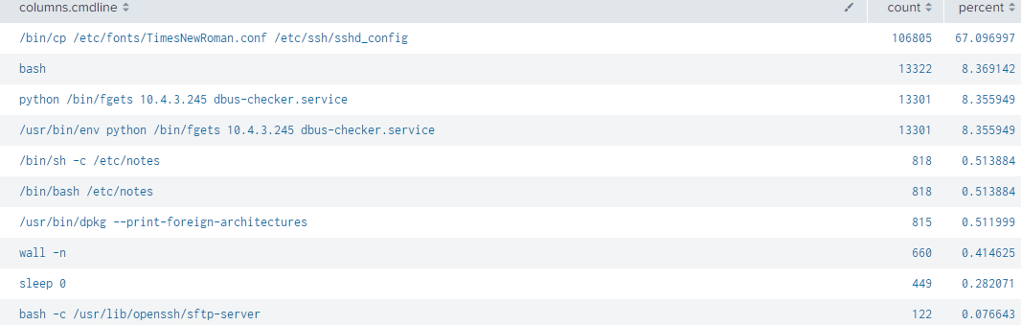
Them random facts be here
Random facts
Each team had about 120,000 events get logged
Team 9 got drunk and had slightly more at 250,000
Most used commands (on team 9)
Notes:
Some teams had way more and way less than 120,000 but quite a few had within 10k of it.
So an interesting side effect of how osquery gets the commands is that it seems like it grabs the commands twice for a few specific things, or it could just be two things that are triggered at the same time by two different things.

Slide 4

What happened
It worked kind of, maybe.
Why ¯\_( ツ )_/¯
Firewalls on pfsense not the cause.
Clients mostly not the cause.
Splunk itself was working the whole time.
Edge is a bad browser.
Was working before and after the competition.
Always worked from the white team VPN
Except it worked for some ¯\_( ツ )_/¯
Notes:
One team (that I know of) it actually worked for all the way.
Not actually a fire wall thing. Most likely…
Edge be a bad browser
One team could get to the log in page, edge told them to stay on the log in page ☹
After the fact about half of the windows PCs could log in.
Must be a weird update thing?
It was working before and after the competition and never did not work for me on the white team vpn.
Finally we really just don’t know what happened.

Slide 5

Fun fact I can’t double tap to add title
Osquery caught every command ran on most of the Linux boxes
And I deployed before redteam
Notes:
Red team deployed after logging (mostly team1 is weird) Every time a binary got moved, a process_event was triggered.
annnnddddd I deployed before red team

Slide 6
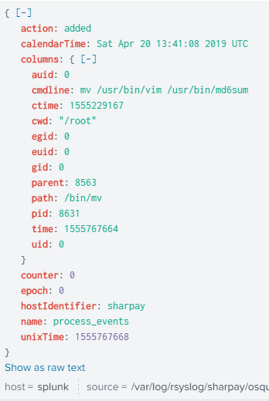
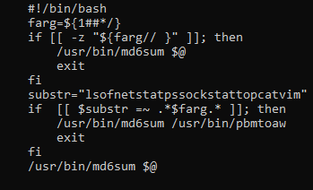
The shim
Poor vi people only think about vim
Notes:
Its pretty silly easy to see shims
From the osquery we can see that vim has been moved to md6sum
Later on they replace it with what is seen in the lower left.
During this I found an interesting little fact, one does not simply run vim, they run vim.basic
And there are more vim….s slim,diff

Slide 7

Sadly red team does not appreciate leaking all the shims…
And lets be real that would get boring real fast
<3 red team
Notes:
Yup sorry can’t leak all the things…
But also <3 red team

Slide 8
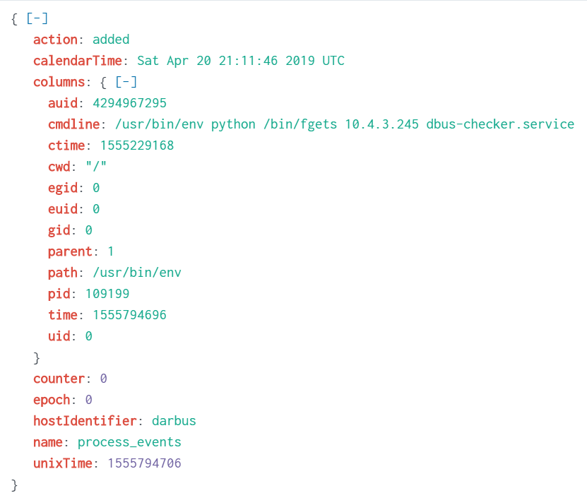
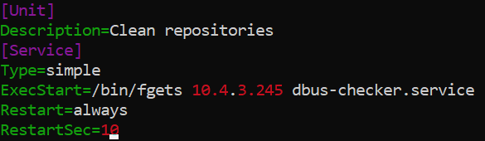
I see your service and raise you an dbus-checker
I wonder what fgets is?
Notes:
From the osquery we can see that “fgets” is connecting to a fun little box.
10.4/16 was redteams network
Bottom left is the actual service running…
Its actually a C function but here
fgets is a fun little python boi

Slide 9

Crontab… The service
Yeah Yeah only one ☹
I still <3 u
Notes:
The crontab boi may have ran a few times o.o

Slide 10
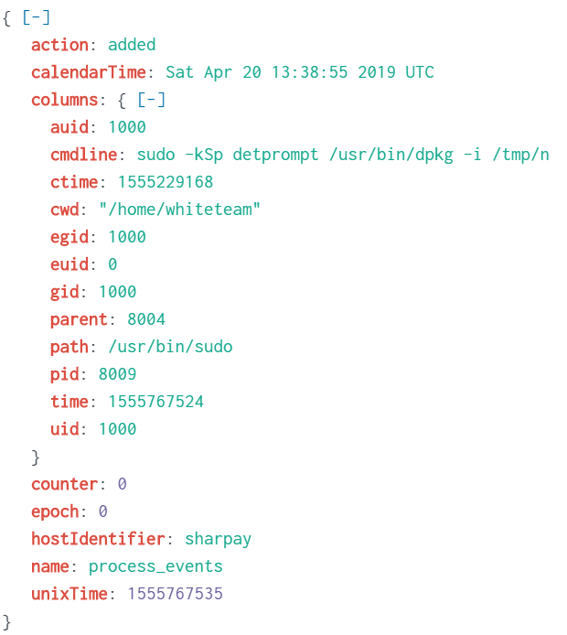
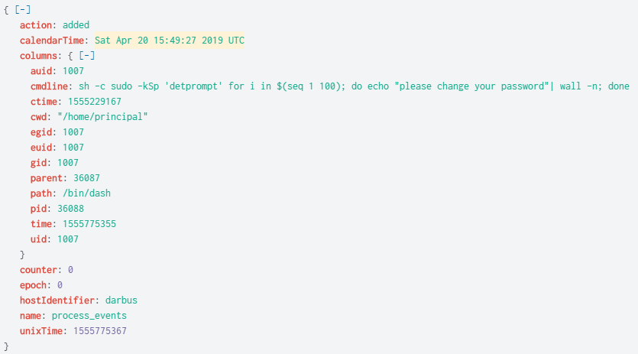
Remember detcord from redteam debriefs past? I sure do
That be an install there
So did you change them?
Notes:
Detcord installed a fun little boi that they moved on the box earlier.
Detcord was also used for some of the fun prompts you got like this one asking you to change your password

Slide 11
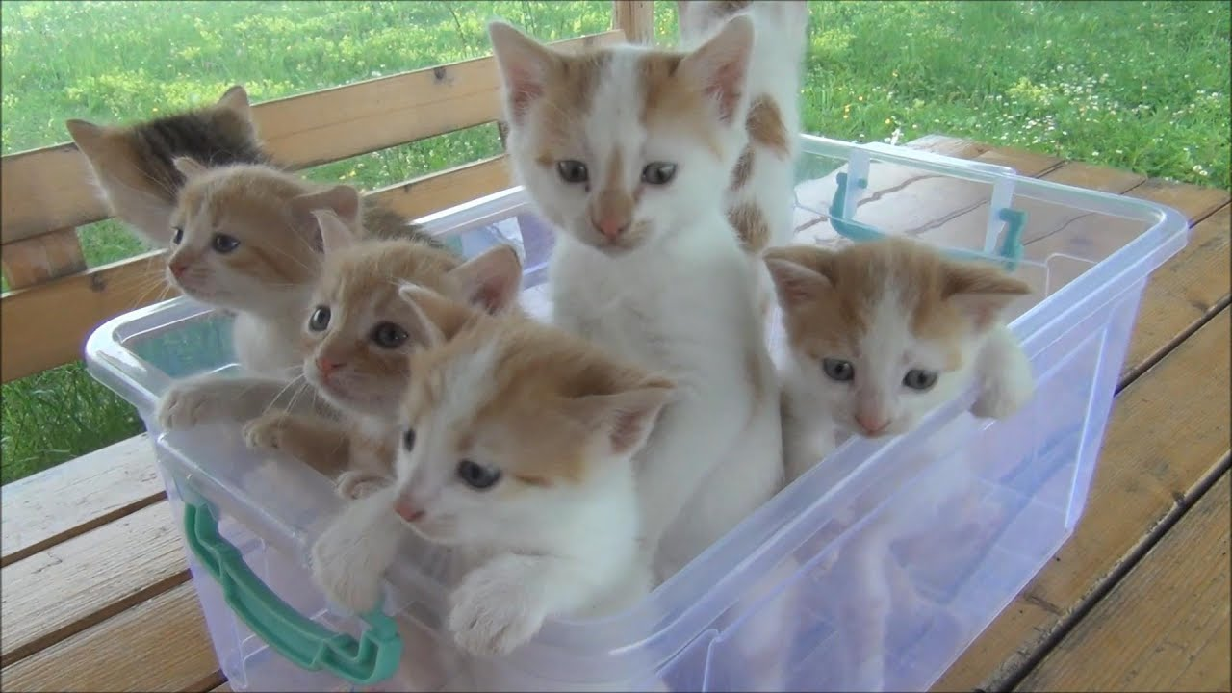
There be some pam but… You know the story
Lets be real red team is actually a bunch of kittens you just want to hug ☺
I still <3 u

Slide 12
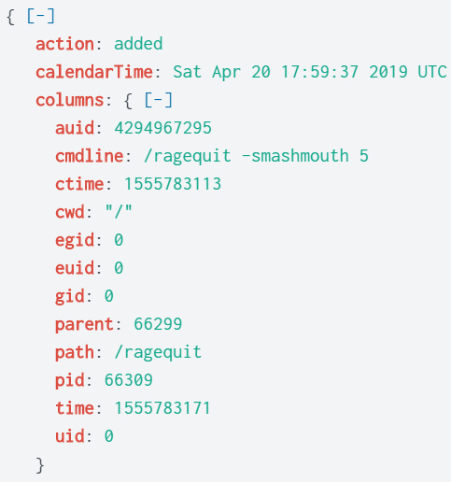
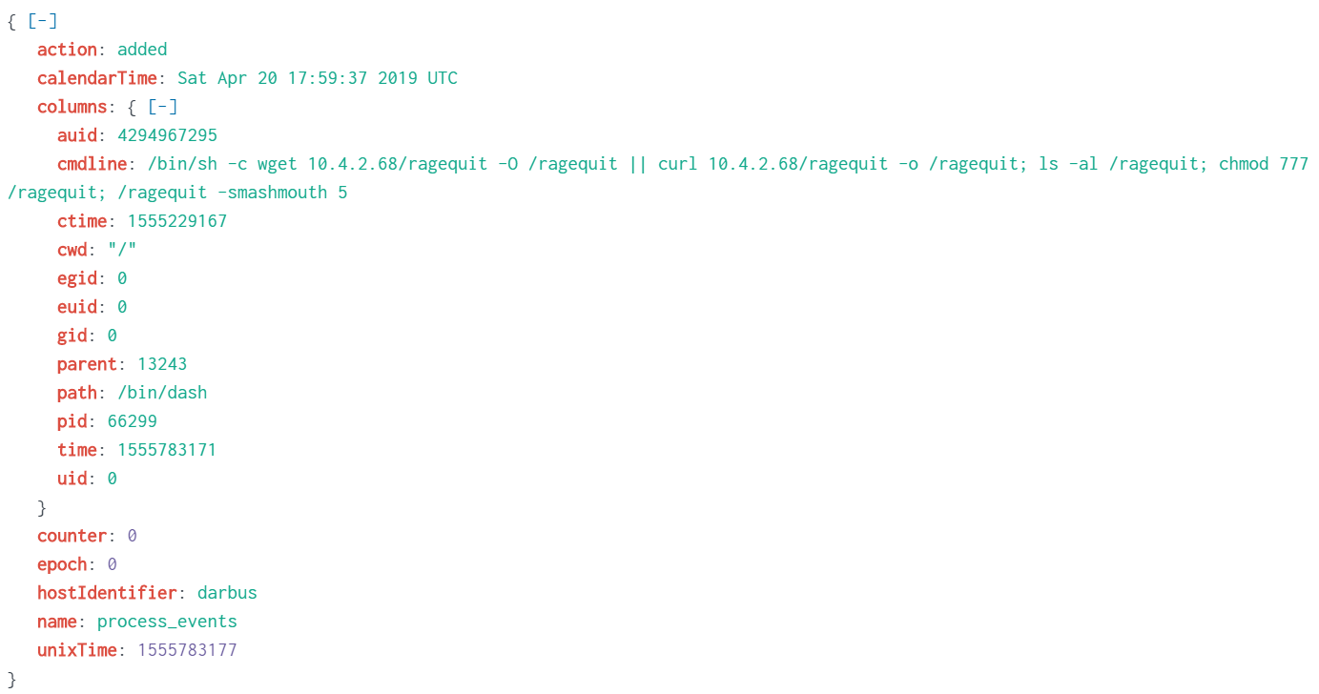
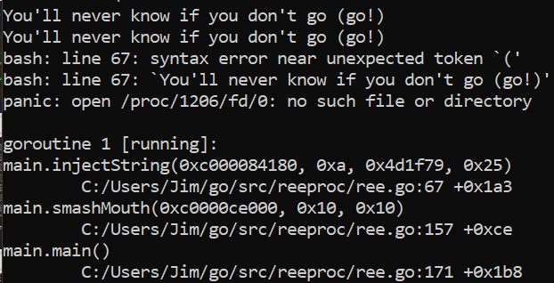
Ragequit makes me want to watch that really old hotwheels movie
Ragequit seems like a lot of fun really,
why would you want to quit?
Notes:
So ragequit was in the red team presentation
They showed the bees buzzing around and some smashmouth fun times. Which we can see here on the right.
On the left is the deploy of ragequit, making sure even if wget or curl is not on the OS it will still deploy.
But fun fact it really does not like it when you just go out and run it yourself, much error many wow.

Slide 13

Takeaways
Logging should not be turned on early.
Context is still important
The process event search pretty damn OP
A lot did not get logged.
Some things got a little spammy.
I’m looking at you docker + iptables
Notes:
Logs can point you in the right direction but a file name and path is not that helpful, what is the file what is it doing? Turns out lots of the weird malicious things are actually just normal files that got moved
Whos running the commands?
Pre competition I was working with Nick and he noticed one of the searches would find reverse shells, guess who had lots of shells? Guess what did not show up… The reason for that was a it excluding 10/8 Pretty much making it useless
We also noticed the Iptables would be pretty solid, but it too failed pretty hard, thanks docker.
"process_events":{ "query": "SELECT auid, cmdline, ctime, cwd, egid, euid, gid, parent, path, pid, time, uid FROM process_events WHERE path NOT IN ('/bin/sed', '/usr/bin/tr', '/bin/gawk', '/bin/date', '/bin/mktemp', '/usr/bin/dirname', '/usr/bin/head', '/usr/bin/jq', '/bin/cut', '/bin/uname', '/bin/basename') and cmdline NOT LIKE '%_key%' AND cmdline NOT LIKE '%secret%';", "interval": 10 }

Slide 14

Questions Demo?!?!?!
Notes:
So if I have time and anyone wants something specific searched for, splunk still exists for another couple of days.

